Slide 1
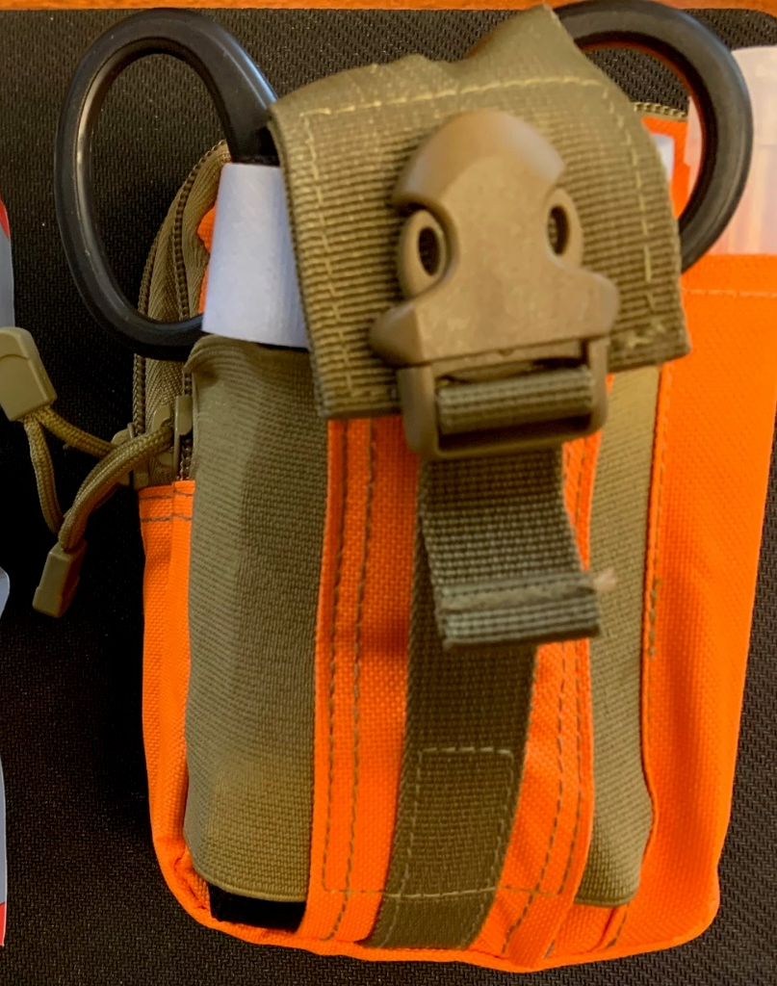
SavingLivesAmerica.org
Using “Stop the Bleeding” Kits
Special Thanks to the Forsyth County S.O.

Slide 2
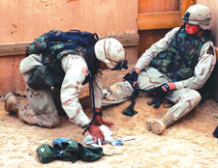
Controlling Bleeding

Slide 3
Introduction
Bleeding from an arm or leg can usually be controlled by:
Emergency Trauma Dressing
Manual pressure and elevation
Tourniquet

Slide 4
Introduction
In some situations a tourniquet is applied first since other methods will not be adequate to control the bleeding.
In combat, a tourniquet can be applied quickly to control serious bleeding. Once you have time to properly evaluate and treat the casualty, you may want to apply an emergency trauma bandage or pressure dressing and loosen the tourniquet. This will make it more likely that the limb can be saved (not amputated).

Slide 5
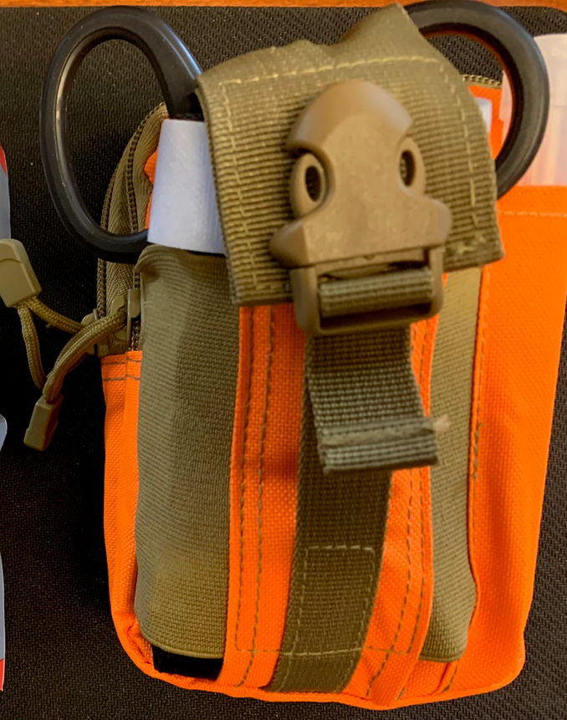
Outer Pouch
Tourniquet
Trauma Scissors
Chem-light

Slide 6
Applying a Combat Application Tourniquet (CAT)

Slide 7
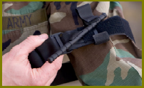
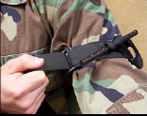
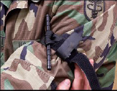
Applying a Combat Application Tourniquet (CAT)
Remove CAT from pouch
Slide wounded extremity through loop of Self-Adhering Band
Position CAT two inches above wound
Pull free running end of Self-Adhering Band very tight and securely fasten it back on itself
Do not adhere the band past the windlass clip

Slide 8
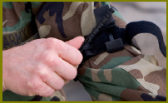
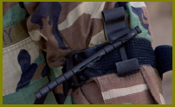
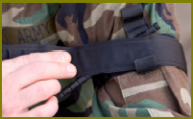
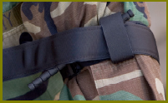
Applying a Combat Application Tourniquet
Twist windlass rod until arterial bleeding
has stopped – Do Not over tighten as may break!
** The original application should be Very Tight before using windlass!
Lock rod in place with windlass clip
Secure rod with windlass strap
Secure Self-Adhering Band under windlass strap
Secure windlass strap to Velcro on windlass clip

Slide 9
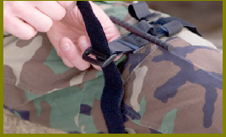
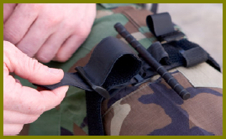
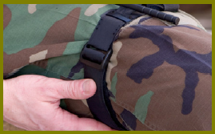
Applying a Combat Application Tourniquet (CAT)
The friction adapter buckle is not necessary for proper CAT application to an arm. However, it must be used as added protection when using two hands to apply the CAT to a leg

Slide 10
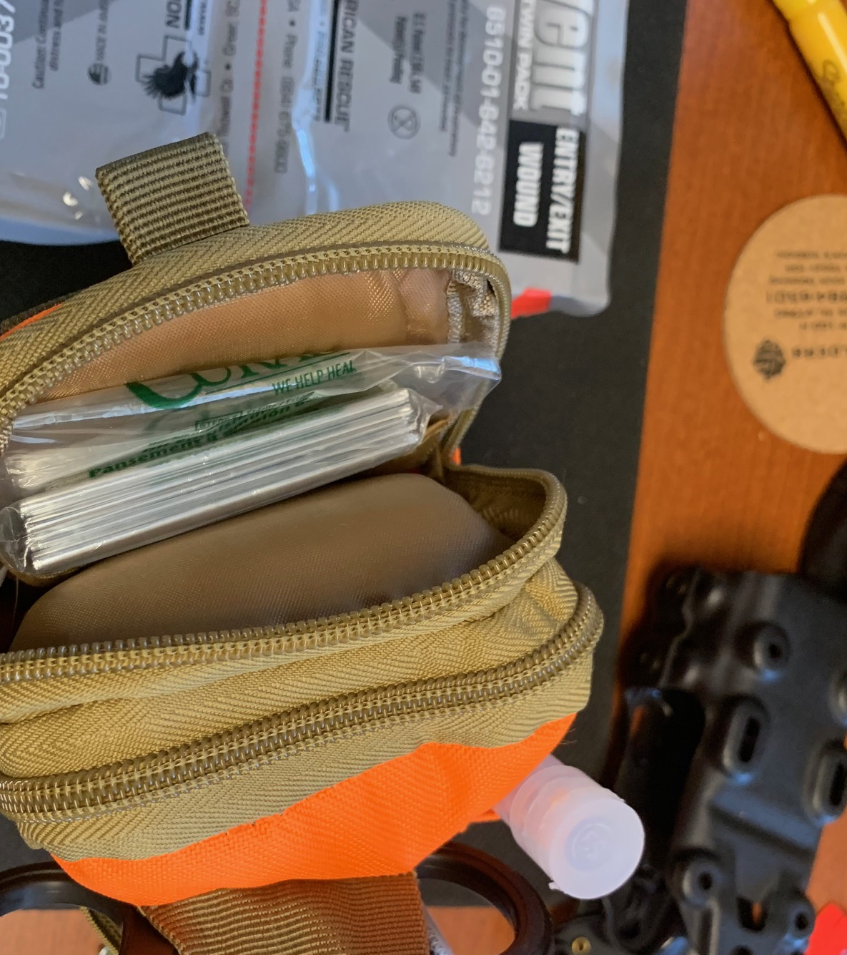
Pocket 1
First Aid Dressings
Tape/wraps

Slide 11
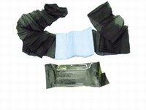
Field First Aid Dressing
The field first aid dressing is being replaced by the emergency trauma bandage, however, you still may come across them

Slide 12
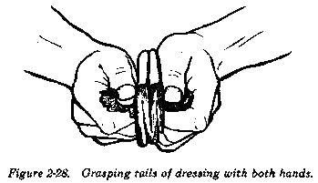
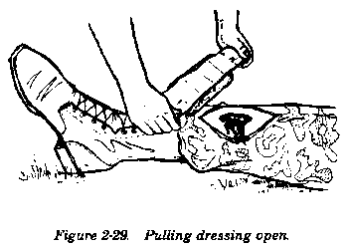
Apply a Field First Aid Dressing
Open plastic packet and remove paper wrapper
Twist paper packet until it breaks open
Remove dressing from paper wrapper
Grasp olive drab tails with both hands
Hold dressing directly over wound with
white side of dressing toward injury
Pull on tails until dressing opens and
flattens

Slide 13
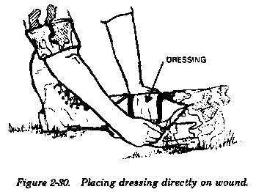
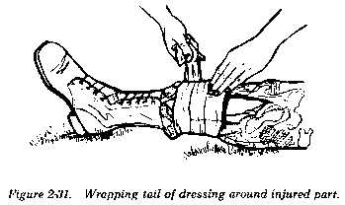
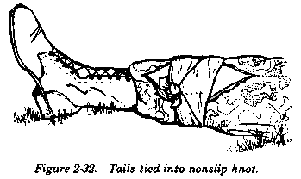
Apply a Field First Aid Dressing
Place white part of dressing over wound
Place hand on top of dressing to hold
in place
Wrap tails around limb (opposite directions)
with free hand, covering the exposed sides
of the dressing
Tie tails into a nonslip knot over the
outer edge of the dressings
Check circulation below the bandage

Slide 14
Pocket 2
Occlusive Dressings
Emergency Blanket
Pocket 3
Self Adhering bangage 4”
Plastic Zip bag –
2X 3”x3”Oil Emulsion gauze
Large stack of 4x4’s

